Slide 1

Bikes Sales In December 2021

Slide 2
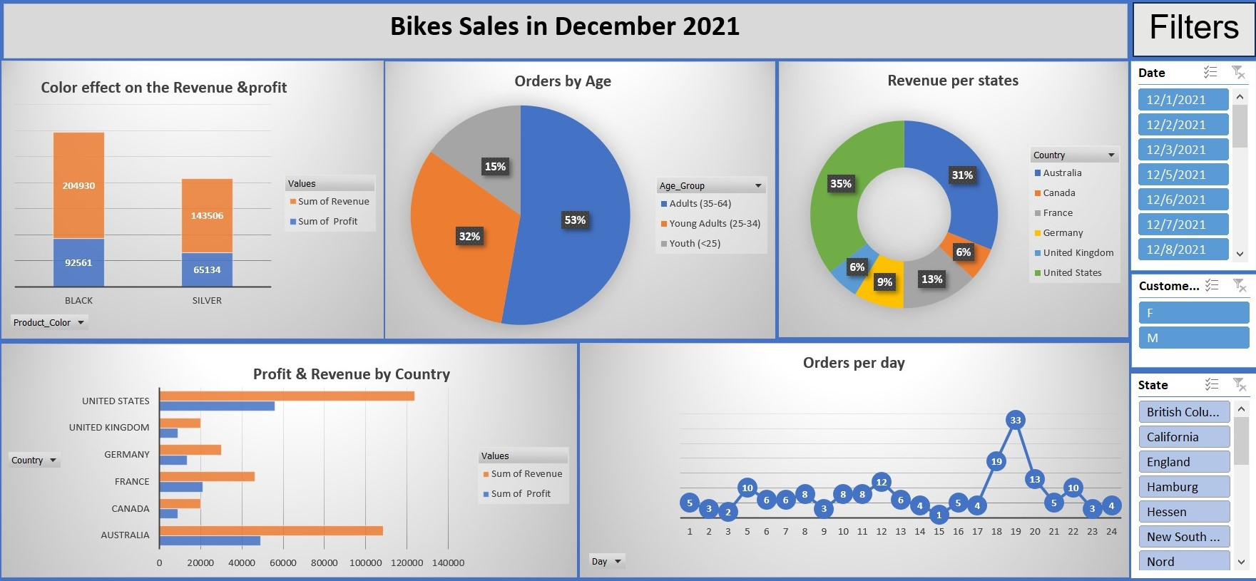

Slide 3
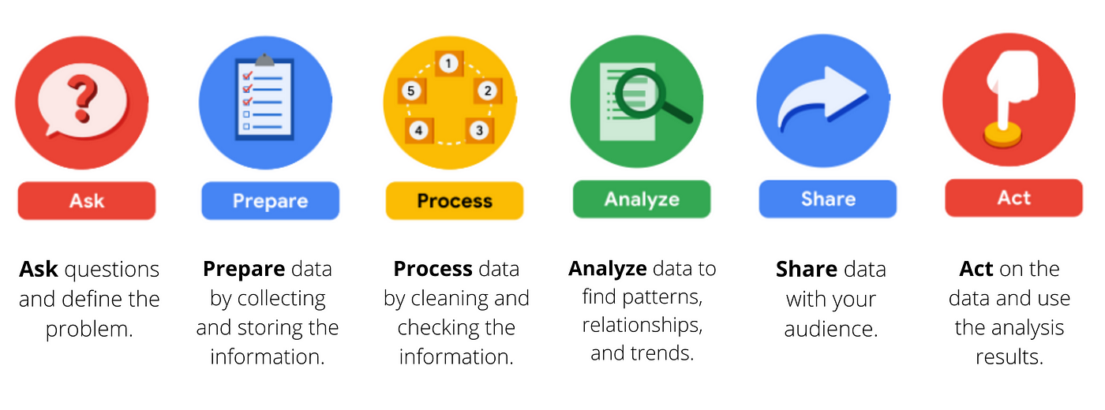
Data Analytics Life Cycle
Data Analytics Life Cycle

Slide 4
Ask Phase:
Which color generates the most profit?
Which age group purchases the most bikes?
Which states generate the highest revenue?
How do revenue and profit differ between countries?
Which days have the highest number of orders?

Slide 5
Prepare:
Data Cleaning: Use Power Query to change column types, rename columns, and remove unnecessary columns.
Remove Duplicates and Errors: Ensure data is free from duplicates and errors to guarantee accurate analysis.
Add Conditional Columns: Create new columns based on specific conditions to facilitate later analysis.

Slide 6
Process:
Organize Data into Tables: Convert data into structured tables for easy access and analysis.
Use Formulas: Apply formulas like SUMIFS and COUNTIFS to calculate key values.
Set Up PivotTables: Create PivotTables to summarize data and facilitate information extraction.

Slide 7
Analysis:
Age Group Analysis: Study the distribution of orders by age group to understand customer behavior.
Revenue Analysis by Country: Compare revenue and profit across countries to identify the most profitable markets.
Daily Performance Analysis: Examine daily changes in order numbers to identify patterns and trends.

Slide 8
Conclusion :
Focus on Profitable Colors: Prioritize marketing for colors that generate higher profits.
Target Key Age Groups: Tailor campaigns to age groups with higher purchase rates.
Expand in High-Revenue Areas: Increase efforts in states and countries with strong sales.
Optimize for Peak Days: Adjust operations to align with peak sales days.
These strategies can enhance sales and drive business growth.

